Slide 1
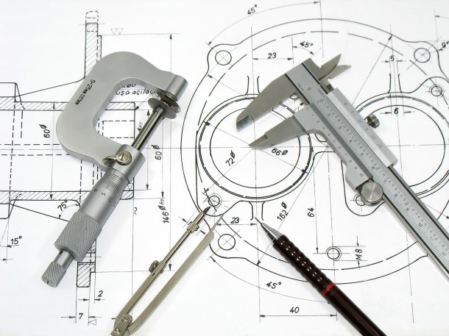

Drawings

Slide 2
10/1 The video task
https://www.youtube.com/watch?v=z4xZmBpXIzQ
What is engineering drawing?
Name some drawing instruments.
What are their uses?
Name and draw some lines.
Students own answers.

Slide 3
10/2 Read and listen to the text
Watch the lines above

Slide 4
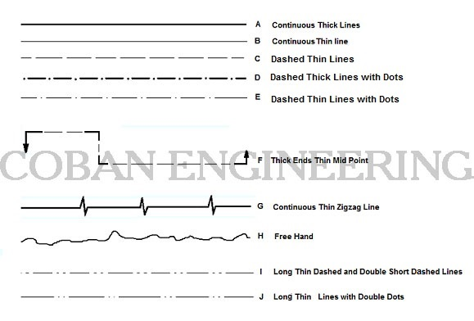
Types of lines

Slide 5
10/3 Choose the correct term from the chart above and match it with one of the definitions
Extension lines* Dimension lines* Continuous Thick Line* Continuous Thin line* Dashed Thin Lines* Dashed Thick Lines with Dots* Dashed Thin Lines with Dots* Chain Thin with Thick Ends* Continuous Thin Zigzag Line* Free Hand Line*
are parallel lines that extend out from two points on the drawing …
are drawn with an arrow on either end between two extension lines …
Surroundings and sides of the matters ( Outlines of the Edges), End of …
Measure lines, Backside section lines, Implied axis lines, to state …
Invisible/Hidden Lines represents an invisible edges on the on an objects
To state the special places/surfaces which will processed additionally like to coat, to
Axis lines of symmetrical drawings, In front of section plans
Cutting Plan, To draw the trace at section plans
It is used when free hand lines are drawn by tools
Limits of partial and interrupted views and sections

Slide 6
Answers
Extension lines are parallel lines that extend out from two points on the drawing.
Dimension lines are drawn with an arrow on either end between two extension
Continuous Thick Line: Surroundings and sides of the matters ( Outlines of the,
Continuous Thin line: Measure lines, Backside section lines, Implied axis lines,
Dashed Thin Lines: Invisible/Hidden Lines represents an invisible edges on the
Dashed Thick Lines with Dots: To state the special places/surfaces which will
Dashed Thin Lines with Dots: Axis lines of symmetrical drawings, In front of
Chain Thin with Thick Ends: Cutting Plane, To draw the trace at section planes,
Continuous Thin Zigzag Line: It is used when free hand lines are drawn by tools
Free Hand Line: Limits of partial and interrupted views and sections

Slide 7
Explain in English
Technical Drawing Views
Projected Two View Drawing
Auxiliary View

Slide 8
10/4 Choose the correct term and match it with one of the definitions
title block* The revisions block* The next assembly block* The notes list* The field of the drawing*
is an area of the drawing that conveys header-type information about the
(rev block) is a tabulated list of the revisions (versions) of the drawing,
often also referred to as "where used" or sometimes "effectivity block", is a list
provides notes to the user of the drawing, conveying any information
is the main body or main area of the drawing, excluding the title block,

Slide 9
Answers
title block is an area of the drawing that conveys header-type…
The revisions block (rev block) is a tabulated list of the revisions….
The next assembly block, often also referred to as "where used" or….
The notes list provides notes to the user of the drawing, ….
The field of the drawing (F/D, FD) is the main body…..

Slide 10
10/5 Work out the dictionary
Work out a dictionary for each bold expression in this unit.
Put it into alphabetical order
Find phonetic transcription
Write it into your text book

